Slide 1



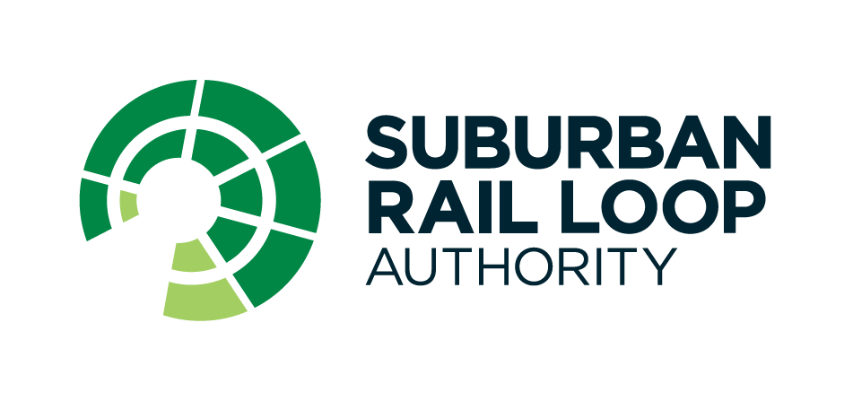
www.intelia.ai
Case Study – Uplift of Power BI Dashboards
Solution Delivery
Visualisation and insights (Power BI dashboards including paginated reports)
Trend analysis capability
Data validation testing and reconciliation
Data quality issues logging and management
Problem
Solution
The Suburban Rail Loop is an ambitious project uplifting Victoria's rail network, transforming daily travel for millions of commuters.
A project of such size and scale relies heavily on comprehensible and complete reporting to drive informed planning and management of the SRL project.
With SRLA’s existing Power BI platform, the reports & dashboards provided a view of recent data but did not offer ‘time travel’ ability to view a historical range of data for trend analysis. Additionally, existing data quality issues affected the accuracy of the dashboards.
To overcome limitations of the existing dashboard and to provide additional features and enhancements, intelia rebuilt the visual presentations of the 22 Power BI dashboards and modernised the look and feel aligning with the Design team’s specifications.
To optimise the reports’ usability, intelia collaborated with SRLA’s Power BI Lead to ensure the new data models were fit for BI reporting. intelia:
Enabled the ability to ‘time travel’ and apply historical data views for trend analysis,
Continuously improved data quality issues found on the new eDAR (Enterprise Data Analytics and Reporting) semantic data models (sourced through Databricks instead of legacy applications), to improve accuracy of the dashboards,
Maintained a log of data quality issues to be addressed at the source or managed through the data model design, and
Performed data validation and reconciliation tests to ensure data accuracy, completeness and overall integrity, during the dashboard development process.
intelia’s Approach
intelia was engaged to provide Data / Business Intelligence (BI) engineering expertise over 12 weeks to deliver 22 Power BI dashboards (including paginated reports), ranging from simple and medium to complex reporting with drill-down features.
The engagement specifically required the uplift and refactoring of existing Risk, Cost, Schedule and CEO monthly dashboards to enable trend analysis, capture additional data on the reports and address data quality issues.
Working closely with SRLA’s Power BI Lead and key business report-consumers, intelia built and tested the reports adopting an iterative process and collaborative approach to enhance the usability and informativeness of the insights presented.
SRLA
Suburban Rail Loop Authority (SRLA) is responsible for planning and delivering the Suburban Rail Loop (SRL) - the largest infrastructure project in Victoria’s history and the state’s biggest investment in transport and precinct development.
Outcome
Over the 12-week project, intelia successfully revamped 22 critical business dashboards, significantly enhancing their functionality and structure.
The improved ability to analyse business behaviour, risks, costs, and scheduling issues enabled SRLA to make more informed decisions based on comprehensive and accurate insights.
In contrast to the limited scope of the previous reports, the new dashboards provide a holistic view of the business.
Moreover, the uplifted data model and reporting functionality establishes a foundation for future dashboards to leverage trend analysis capabilities.
I am very happy with the level of work that we got from intelia. Their work ethic and desire to ensure that we got the right business outcomes was tremendous and I would definitely have intelia back when we have the need in the future.
- Head of Data and Analytics
With offices in Melbourne and Sydney, intelia is a technology consultancy specialising in all things data (strategy, architecture, governance, analytics, modern cloud data platforms and intelligent automation)

